Slide 1
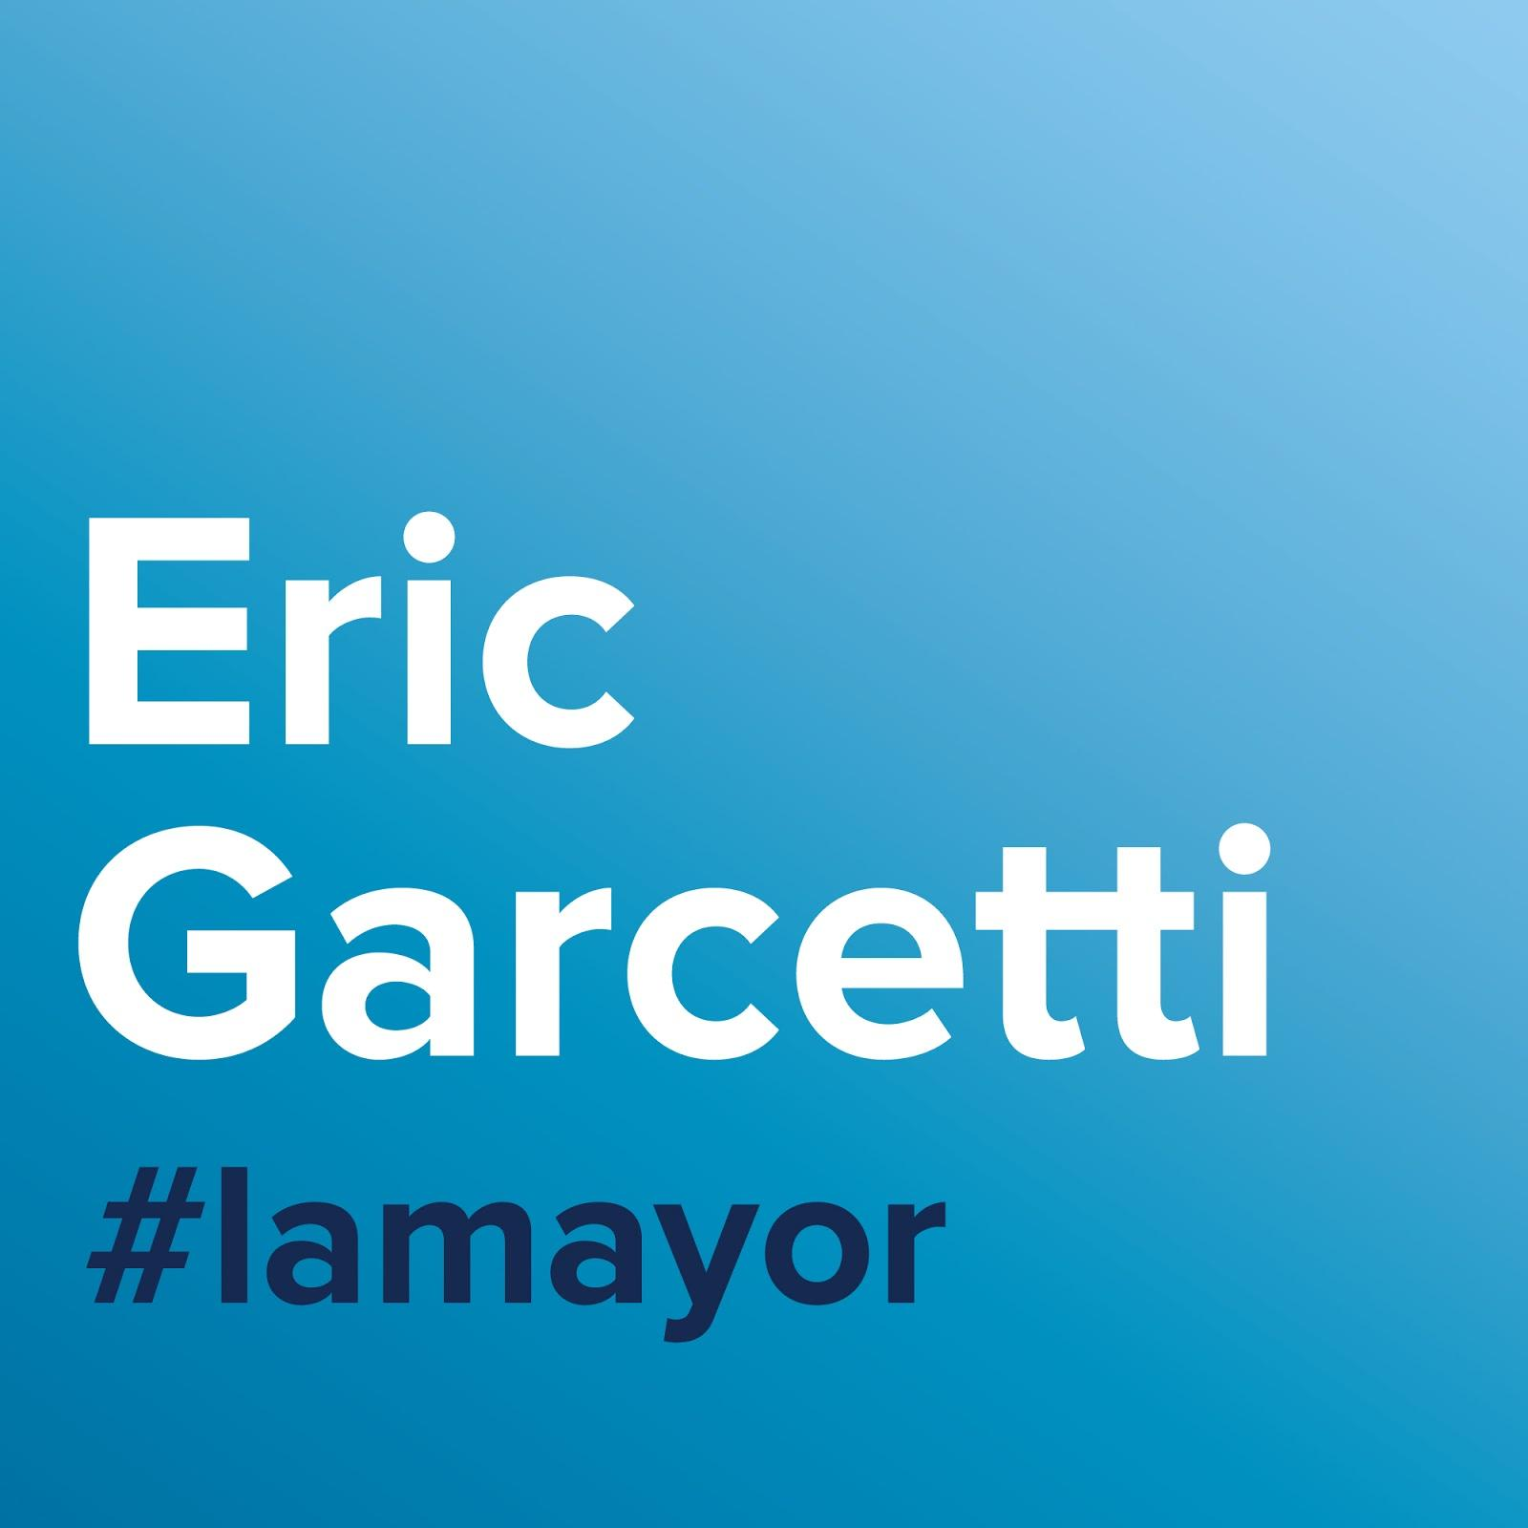
Pathway to Reopening Schools: COVID-19 Rapid Antigen Testing
Attend our parent information session on Wednesday night, 3/24 at 6PM
Learn how we may be able to quickly detect COVID-19 and safely bring back in-person learning
The City of Los Angeles is exploring how children may safely return to school. To do this, we will be offering free, rapid COVID-19 tests, also known as antigen tests, and evaluating how they might be used to reopen schools.
Call in or join over Zoom
Dial XXX-XXX-XXXX Enter meeting ID: XXX XXXX XXXX
Join us on Zoom by clicking or typing XXXXXXXXXXXXXXXXXXXXX

